Slide 2
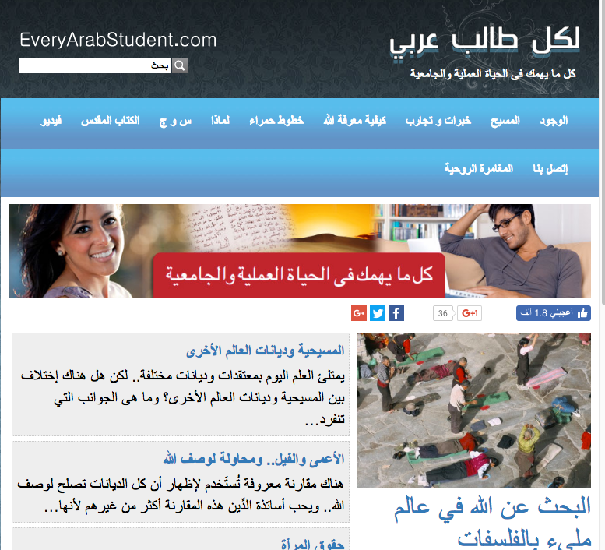

Slide 4
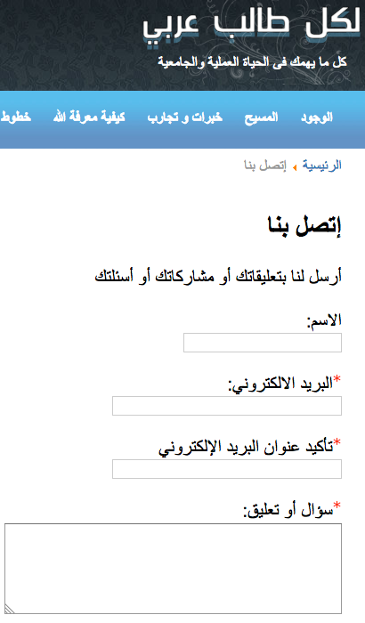

Slide 5
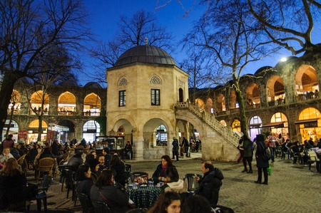

Slide 6
“I decided to use the same method with my friends, to use the Internet in sharing the gospel.”

Slide 8
“I wanted them to know more about God’s kindness, so I sent an email to each one of them and added a link to www.EveryArabStudent.com in the email.

Slide 9
“I prayed that when they click on the link that the Lord would touch their hearts.”

Slide 10
“I thank the Lord because many of my friends who received my email are now spiritual leaders who lead many people to Christ.”

